Slide 1
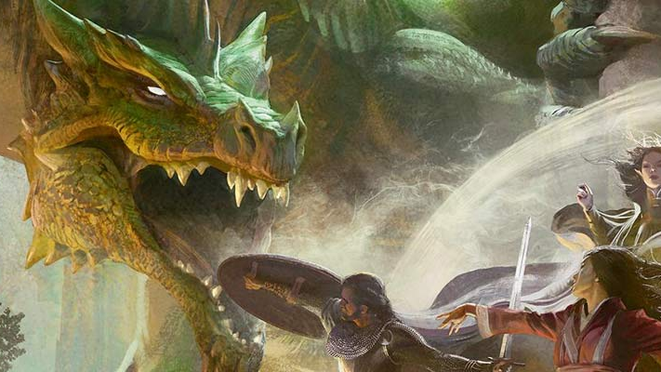
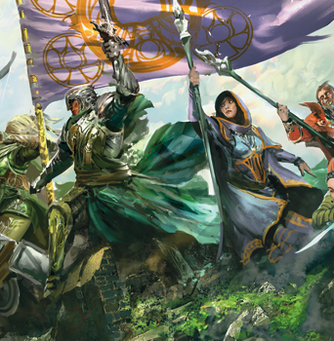

Adventure Day
Created By: Ryan Solnik
Advised By: Dr. Robert Adams

Slide 2

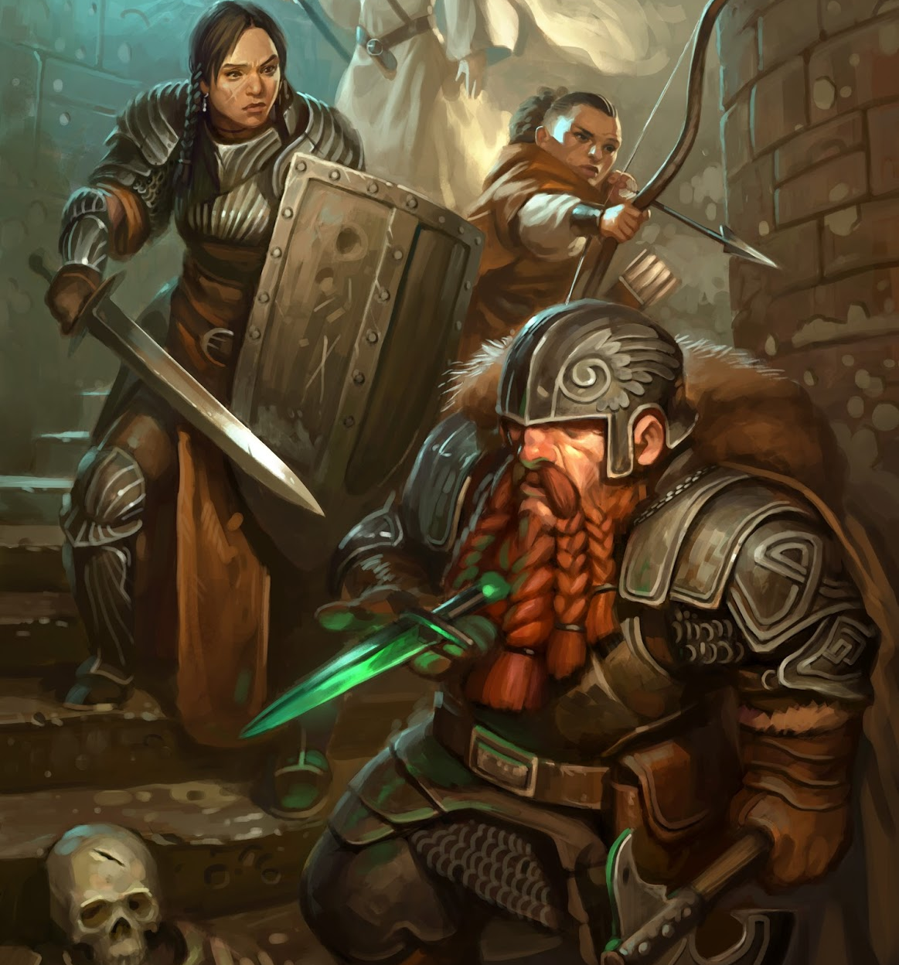
What Problem Does This Solve?
Playing Dungeons & Dragons with friends is a ton of fun!
Preparing the game to be played can easily become a hassle
Outline potential scenes and encounters
Copy monster statistics
Prepare random encounters
Create meaningful Non player characters
There is no guarantee that you will use all you’ve prepared!
The goal of this project is to solve this problem by streamlining the process of preparing a game and help focus on what matters.

Slide 3
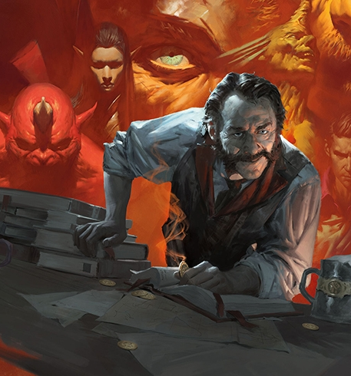
What Is Adventure Day?
Removes busy work of creating and documenting a D&D Adventure while preserving creativity.
Fetches monster statistics from a Database for easy reference during sessions.
Assists in scaling monster difficulties to fit all levels of Adventuring Parties.
Generates encounters with specific monsters or any monsters from a specified environment.
Generates role playing traits for Non-Player Characters from a list quirks and behaviors.
Formats Story Outline, Monsters and NPCs into a cohesive markdown output for use with the Homebrewery website.

Slide 4

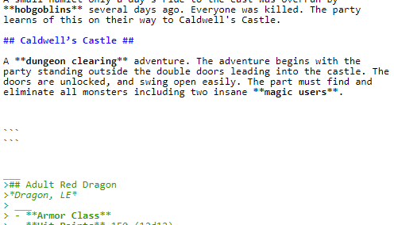
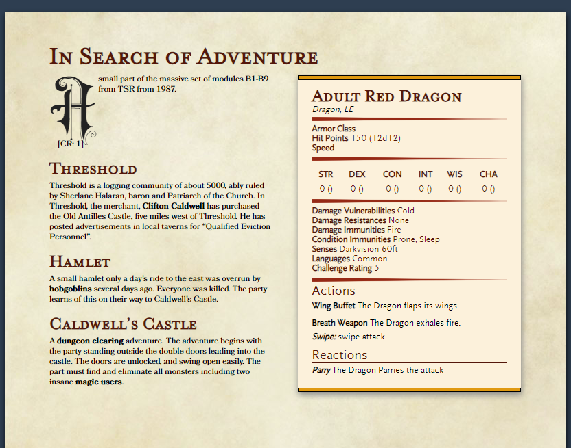
Behind the Dungeon Master Screen
Postgres as a Backend Database to Contain Monsters
Hit points, Attacks, Abilities, Actions, environments
Intersect tables to tie many abilities to many monsters
Text parser in Python created for processing story ideas
Accepts a text file in markdown format with an optional annotated dictionary for additional modifications to data.
Identifies highlighted terms in text and processes dictionary items for further processing
Algorithms for Monster Selection and Querying.
Queries for selecting monsters based on environments and abilities
Constructs monster encounters based on difficulty ranges
Scales monster statistics (AC, HP, abilities, etc…) based on D&D rules
Text formatting to Markdown using Python libraries
Formats Story, NPC’s, and Monsters into a readable format using The Home brewery's formatting rules to read like an actual D&D book.

Slide 5


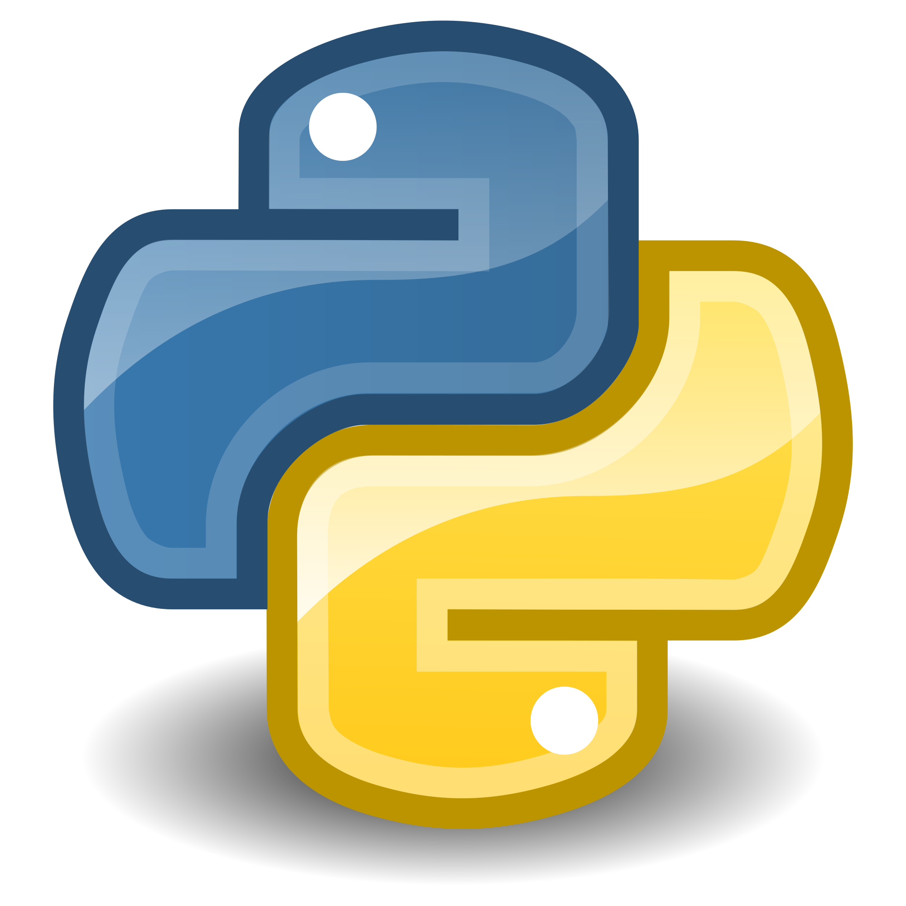
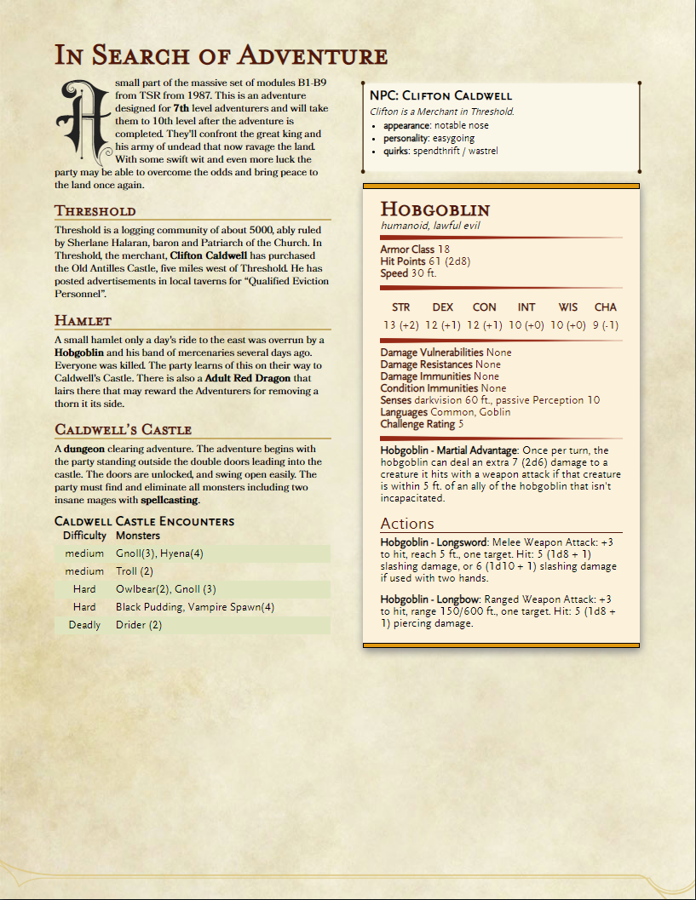
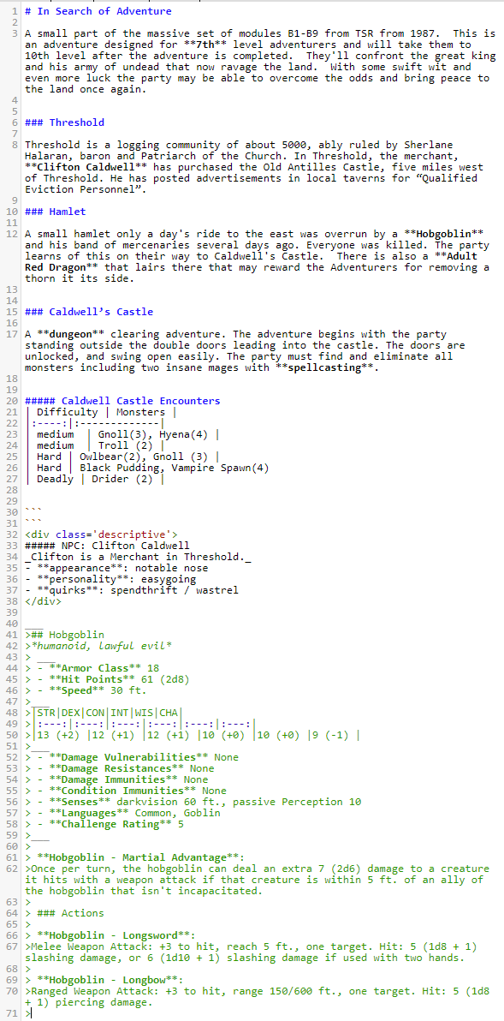
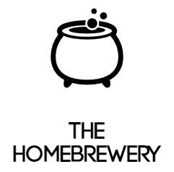


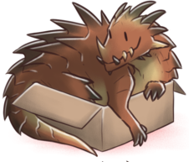
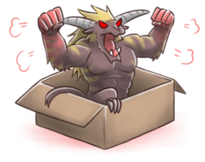

Adventure Day
Overview
Output
Created By: Ryan Solnik
Advised By: Dr. Robert Adams
Adventure Parser
Dungeons and Dragons is a role playing game where one player assumes the role of the Dungeon Master. This player is responsible for dreaming up adventures for the other players to embark upon.
Preparing games for dungeons and dragons can be a daunting task that is filled with lengthy tasks that may not yield benefit when it comes to running the game you’ve prepared.
Adventure Day is a computational solution to streamline the creation process of a D&D Adventure.
Markdown Text parser that interprets tagged words and headings for operations requested.
Dictionary entries to trigger additional actions to be taken on important actors in the story provided.
Dictionary operators can be combined
Level: The rough power level of the adventure that is being created. This informs monster selection.
Name: name of item highlighted in text or monster to be referenced.
Type: Queries the Monster Vault for either a Monster or an NPC characteristics
Location: Creates a set of encounters for adventurers based on the Location the encounter would occur.
Race: Returns a specific type of monster (ex. “Dragon”, “Aberration”, “Goblin” etc…)
CR: sets the challenge rating for the desired Monster up or down based on the number provided.
Ability: Returns a monster with the desired ability listed as a value to the Ability Key.
Gathers markdown text input and tagged items and compiles them into an output that can be formatted with a CSS Stylesheet provided by The Homebrewery. Monsters are provided in stat blocks that are easily readable and story scenes are separated by headings that had been provided in the text file.
{“Name":"Archmage", “Type":"monster", “Race": "human", “Ability": "spellcasting" , "CR": -2}
Solution
Users supply story ideas and tag items of interest in the body of text which will be fetched and represented in the output of the application.
Highlight Headings with markdown headings
Use Bold to highlight items of importance in this case a Hobgoblin is important to the Hamlet Scene.
Define the Dictionary and what actions to be taken. In this case we want to make our Hobgoblin Five Challenge Ratings Higher than it starts at
Monster customization
Scaling of Monster Stats to pose a challenge for Adventurers of any Level.
Addition of statistics is not directly proportional to challenge rating and needs to be evaluated.
Encounter Creation
Based on Terrain type or Monster Abilities
Had to be balanced around Adventure Level and Experience thresholds for varying difficulties.
Non Player Character (NPC) Traits
Generates character traits, quirks, and personalities for character inspiration
Monster Vault
Postgres Database filled with Monster that will be referenced by keywords in the Adventure Text
Important Statistics (AC, HP, Type, etc…)
Special Abilities, Actions, Reactions
Environments Monsters are encountered in
Non-player-character Quirks, personalities, and traits for inspiration.
### Hamlet
A small hamlet only a day's ride to the east was overrun by a **Hobgoblin** and his band of mercenaries several days ago. Everyone was killed. The party learns of this on their way to Caldwell's Castle.
{"name":"Hobgoblin","type": "monster", "CR": 5}
2
3
1
4

